Slide 1

Roomcrawler
A 2D RogueLike game
Ernest Patryk Szymanski
ers17@aber.ac.uk

Slide 2
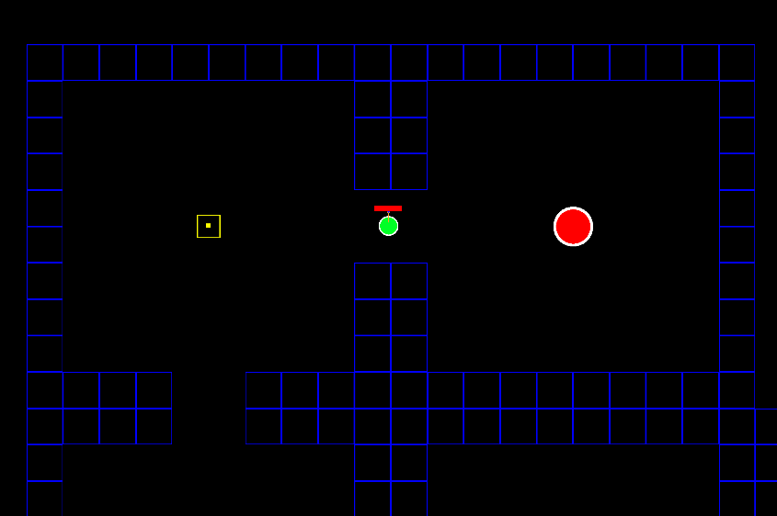
Point of the game
Roomcrawler is a RogueLike game that takes place in 2D world. Main objective for the player is to defeat different enemies, become as powerful as he can and fight the challenging final boss. He will be able to do it by going through various rooms that are randomly generated in multiple floors and collect powerups. In order to move from one room to another he needs to defeat the enemies and then the doors are unlocked to the next room.
Figure 1. A screen from the game showing player, health bar, rooms, boss and the treasure chest

Slide 3
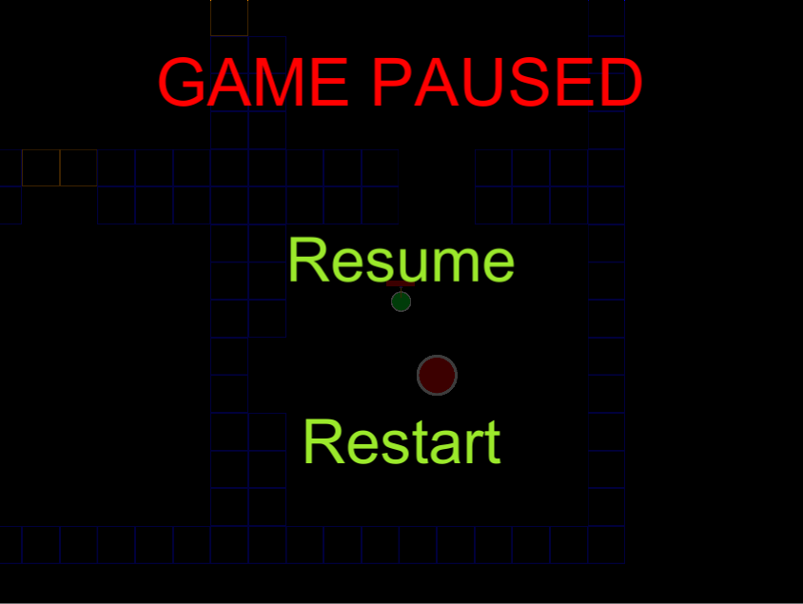
Progress
So far there is a fair implementation of level generation that has some issues but they are not major. Levels are generating quickly and rooms are connected to each other. Last room that is being spawned is the boss room that also spawns a boss enemy. There is a health system and damage system connected with the health bar that are properly working. Player movement is partially completed as there need to be some adjustments to the smoothness of the movement and response time. Shooting mechanics are basic at this point as well. There is also a basic UI implementation.
Figure 2. A screen from the game showing game while it is paused.

Slide 4
Remaining work
I need to make some more research about algorithms and mechanics that I want to implement and improve. I also need to learn more on how to work with Unity Engine and understand how some of the processes are handled in this engine. I need to create some more UI elements. They will be helpful for the player and indicate his current status.

Slide 5
Future work
Mechanics will be implemented step by step. While I will finish one of the mechanics I will move to the next one. Right now there need to be done some of the adjustments to the current mechanics of the game. After that, I will focus on door opening/closing algorithm that works with the enemy number in the room.

